Slide 1
Customer Review Analysis & Classification Mini Project 3
By
Madhu Nuthula
04/01/2023

Slide 2
Problem Statement
Business requirement to extract text from customer reviews and provide valuable insights that can help better the product quality, customer service and also in decision making.
Identity and classify positive and negative feedbacks so that they can take actions and respond to their customers appropriately. Helps to retain customers and increase in revenue.

Slide 3
Importance
Customer reviews are the most powerful tool customers have in their tool-belt before making a purchase. They are the best opportunity to get a real and authentic opinion from fellow customers.
Reviews Establish Trust and Validation
Reviews can help your brand become more trustworthy. Customers generally have no reason to give a business a good or bad review unless it reflects their experience. So, the more positive reviews you have the more trustworthy your business will be perceived.
Positive Reviews = Positive Sales… Negatives Do the Opposite
Brand Communication and Visibility Increases
Respond to Negative Reviews the Right Way
Negative customer reviews don’t always have to have a negative impact on your business. Most of the time a negative review will be a learning opportunity, and if you respond to it properly you can improve your business and your customer’s perception of your business.
Highlight Your Positive Reviews
It is important for business to analyze and draw insights from customer reviews.
Because at the end of the day, we cannot avoid the fact that online reviews will either make or break the business.

Slide 4
About Dataset
This dataset consists of reviews of fine foods from amazon. The data span a period of more than 10 years, including all 500,000 reviews up to October 2012.
Reviews from Oct 1999 - Oct 2012 568,454 reviews 256,059 users 74,258 products 260 users with > 50 reviews
Shape: (568454, 10)
Columns
ID: Row Id
ProductId: Unique identifier for the product
UserId: Unqiue identifier for the user
ProfileName: Profile name of the user
HelpfulnessNumerator: Number of users who found the review helpful
HelpfulnessDenominator: Number of users who indicated whether they found the review helpful or not
Score: Rating between 1 and 5
Time: Timestamp for the review
Summary: Brief summary of the review
Text: Text of the review
Columns used in this Project
Score: Rating between 1 and 5
Text: Text of the review
Features:
Text converted to numeric format using vectorizers
Target:
Feedback Score in binary Classification

Slide 5
Challenges Solution
Binary Classify the feedbacks
Reduce rows for faster performance
Remove multiple spaces, double quotes, urls etc from text
Remove Stop words, punctuations and Lemmatize from text
Prepare the text for Machine Learning using the right method
Evaluate on different type models and optimize the results
Converted feedbacks with 4 & 5 ratings as “Positive” and to numeric “1”. Feedbacks below 3 ratings as “Negative” and to numeric “0”
Chose 2000 samples from the latest year 2012, 1000 from positive and 1000 from negative
Used Spacy and regex for cleaning text
Used Spacy to remove Stop words, punctuations and Lemmatize from text
Used 2 methods Count-Vectorizer and TF-IDF Vectorizer
Evaluated using different modelling techniques Linear SVC, Logistic Regression, Random Forest, Gradient Boosting Classifier

Slide 6
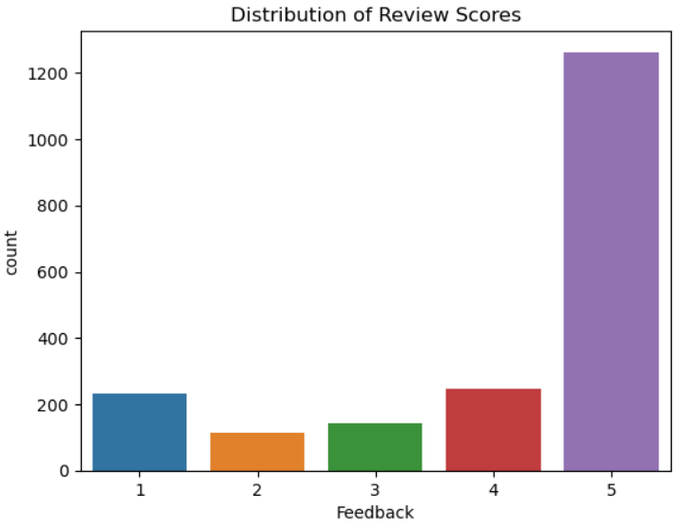
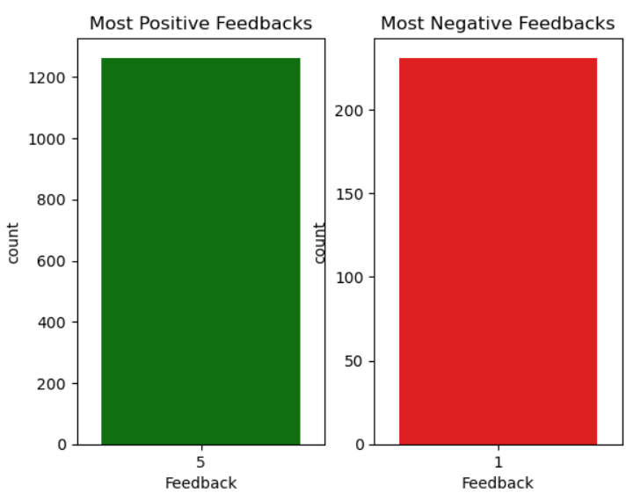
EDA

Slide 7
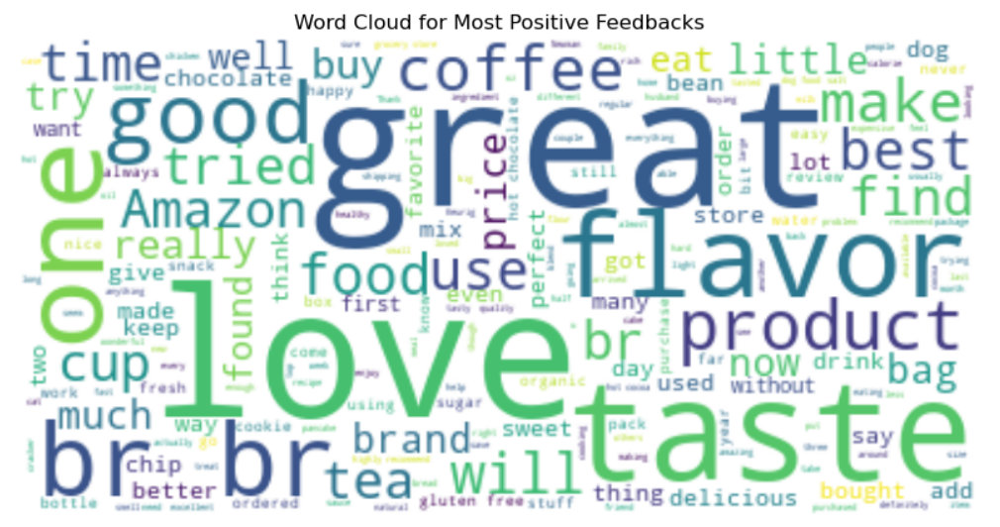
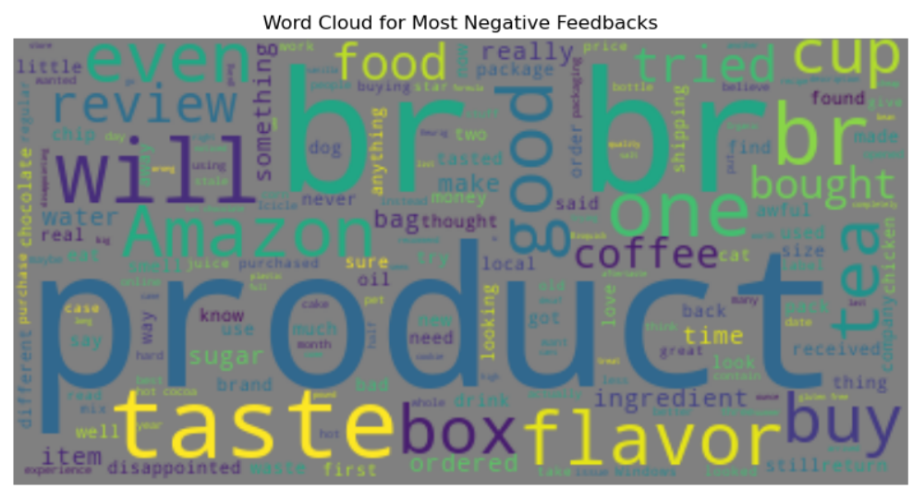
Word Cloud Visuals - Raw Text

Slide 8
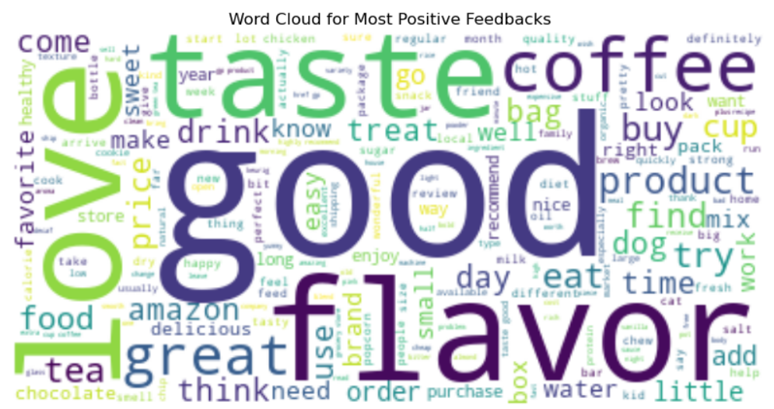
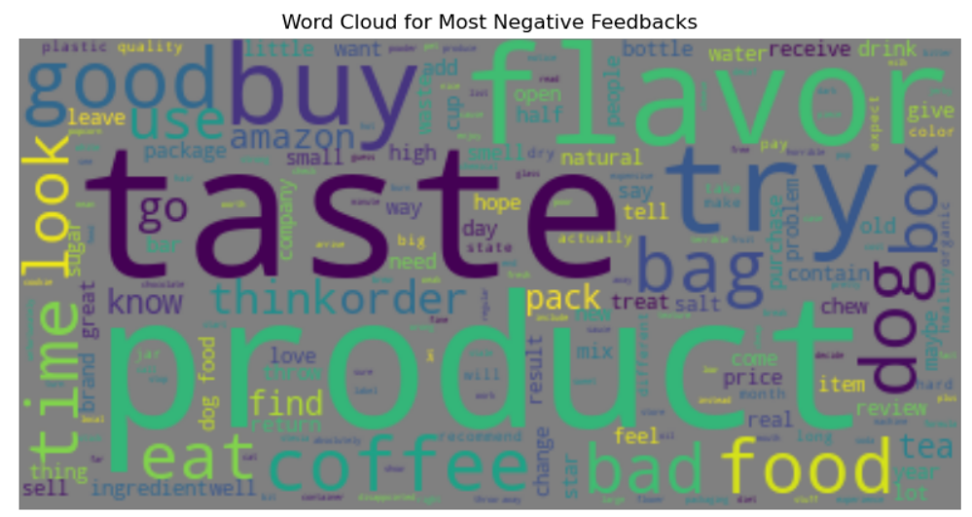
Word Cloud Visuals – Cleaned Text

Slide 9
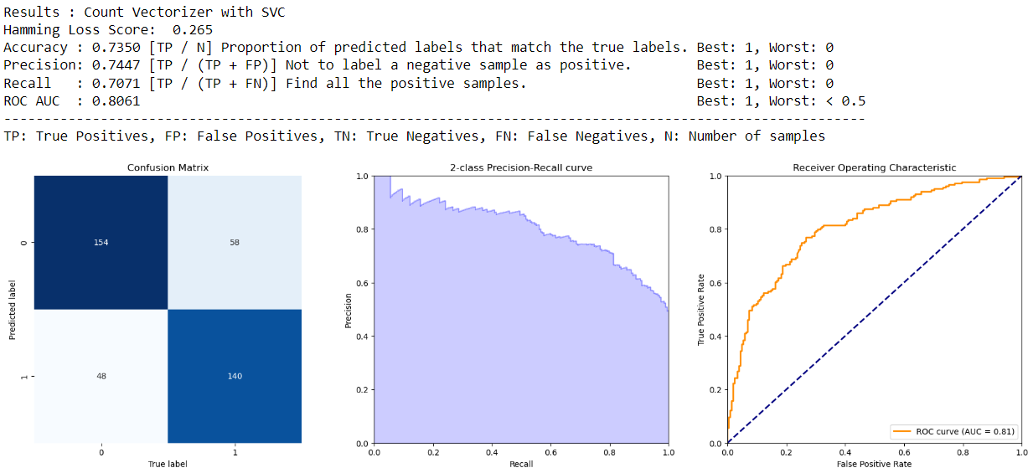
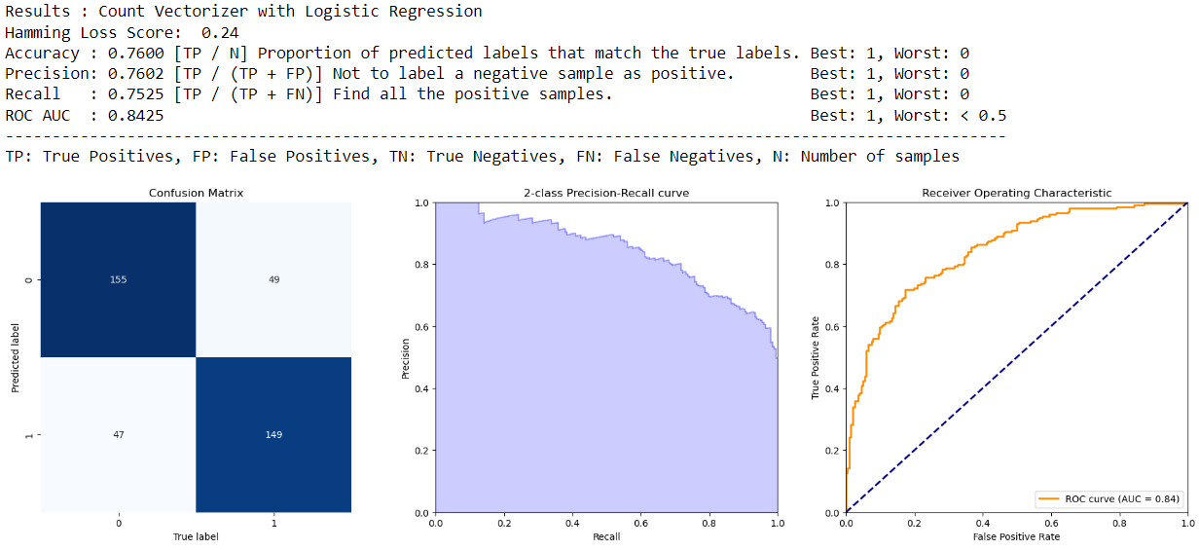
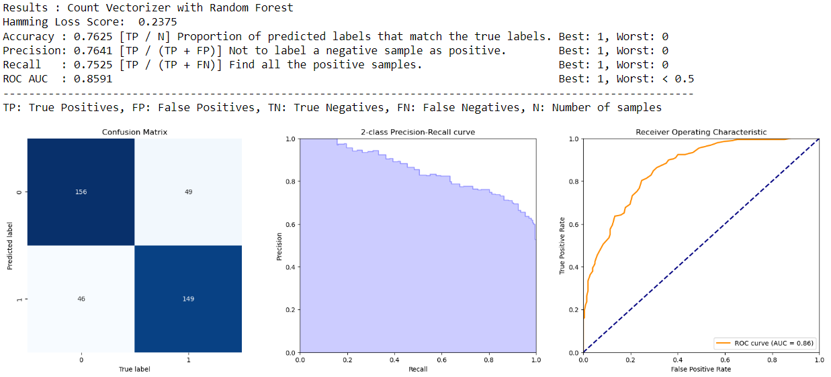
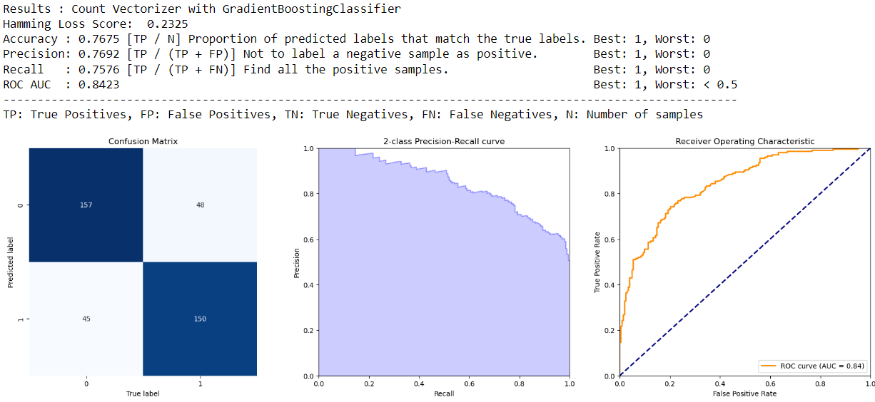
Results Summary – Count Vectorizer

Slide 10
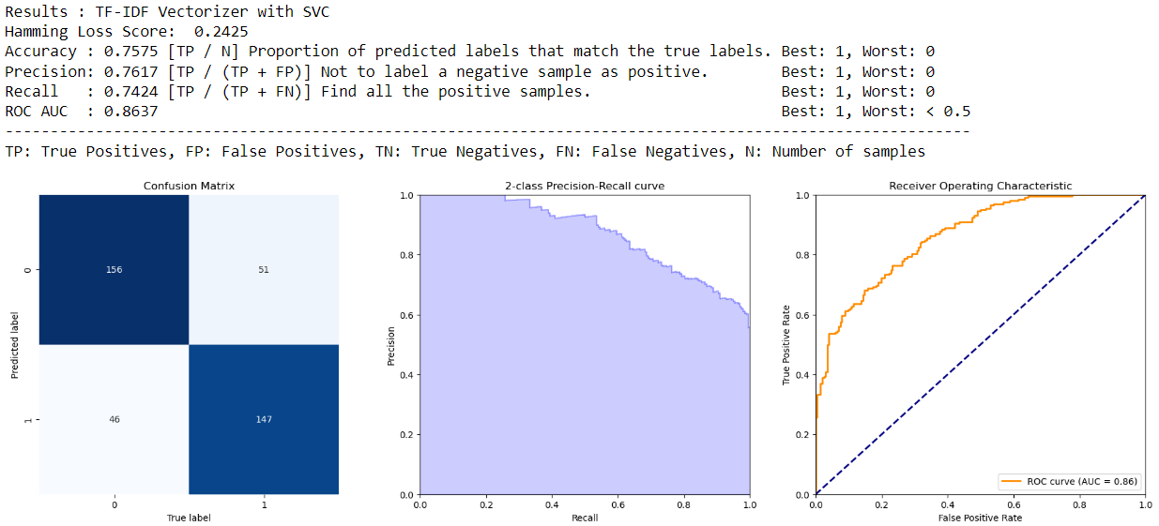
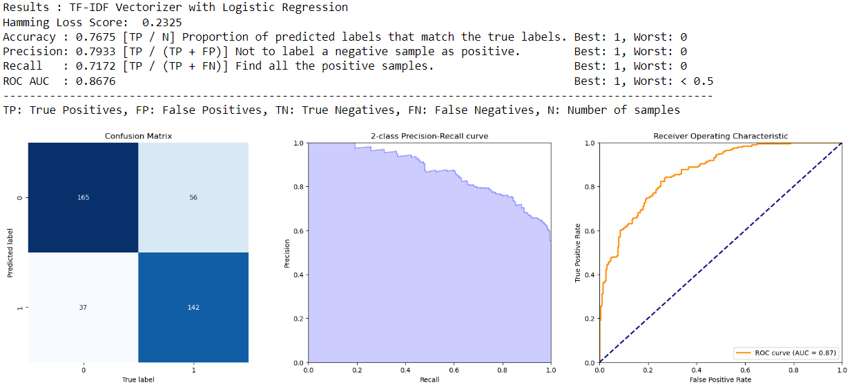
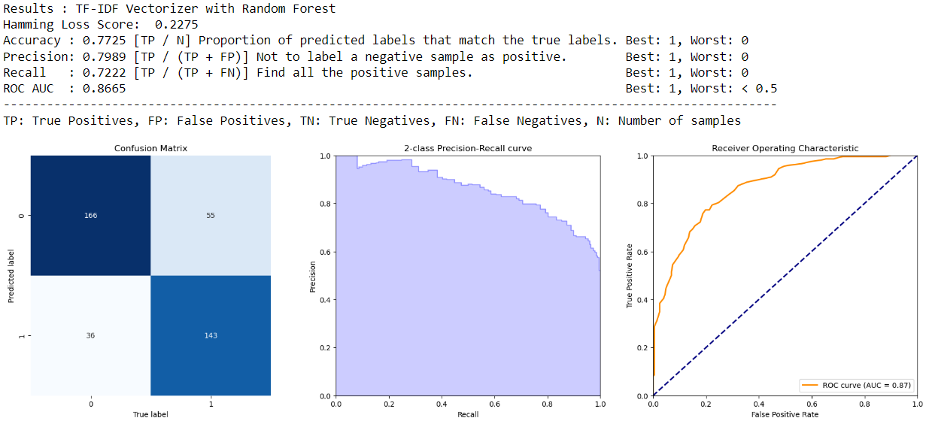

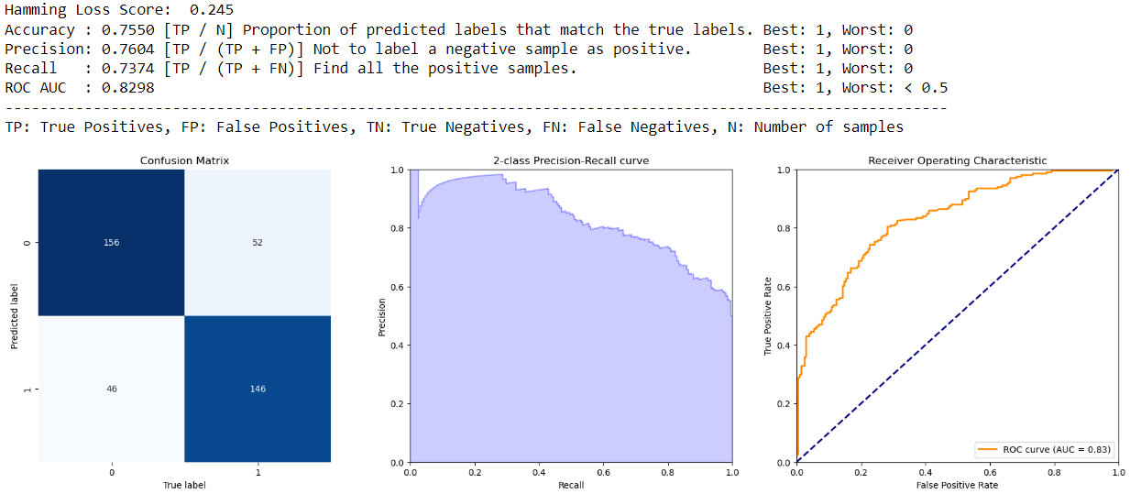
Results Summary – TF-IDF Vectorizer

Slide 11
Best Results
Count Vectorizer with GradientBoostingClassifier
Hamming Loss Score: 0.2325
Accuracy : 0.7675
ROC AUC : 0.8423
TF-IDF Vectorizer with Random Forest
Hamming Loss Score: 0.2275
Accuracy : 0.7725
ROC AUC : 0.8665

Slide 12
Summary
Tried 4 different models (2 linear, 1 bagging and 1 boosting) for two different text processing methods (Count Vectorizer and TF-IDF Vectorizer)
SVC, Logistic Regression, Random Forest and Gradient Boosting Classifier
Focused more to minimize misclassification than accuracy while evaluating the models
Suggestion
Additional text cleaning to remove any common keywords
Feature Engineer focusing on type of words (Noun, Adjective, verb etc)
Advanced Deep Learning models to improve Accuracy and decrease misclassification

Slide 13
References
https://www.business2community.com/customer-experience/the-importance-of-customer-reviews-02400628
https://www.kaggle.com/datasets/snap/amazon-fine-food-reviews
https://www.kaggle.com/code/selinglpek/sentiment-analysis-for-amazon-reviews

Slide 14
Thank You!
End Of Presentation

